Slide 1
Git and Junit Integration with Jenkins

Slide 2



CONTENTS
Git to Jenkins
Unit Testing
Junit to Jenkins
For Internal Use Only

Slide 3

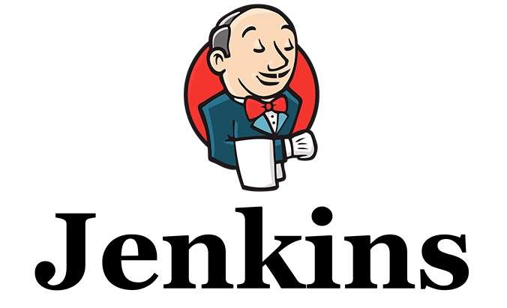
Git to Jenkins
Git is a free and open source distributed version control system designed to handle everything from small to very large projects with speed and efficiency.
Jenkins is an open source continuous integration tool written in Java.

Slide 4
Git to Jenkins
Demo ~

